Slide 1

Using Augmented Reality to Improve Health for Elderly
By Harry Skidmore

Slide 2
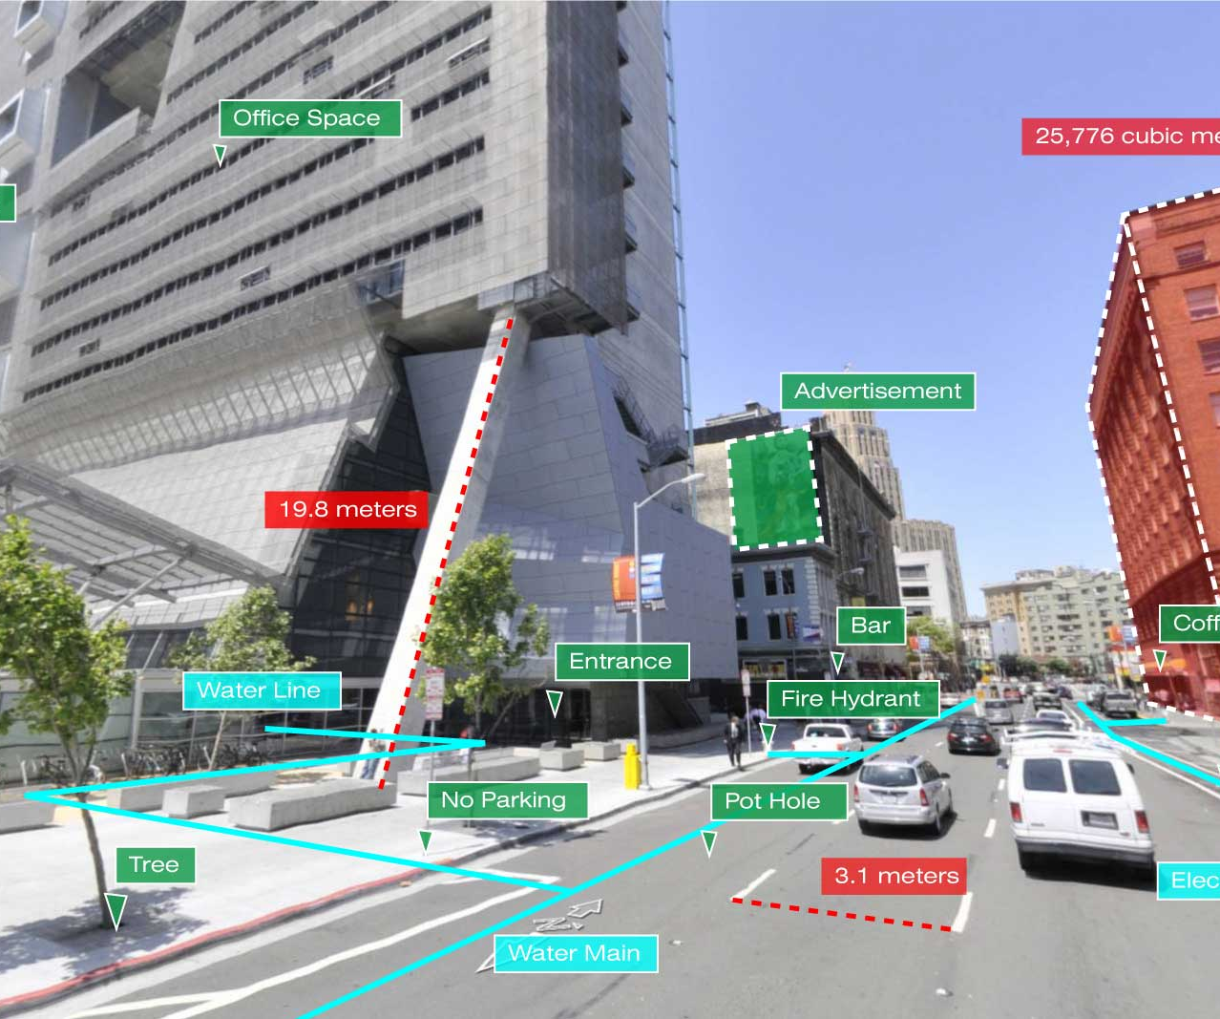

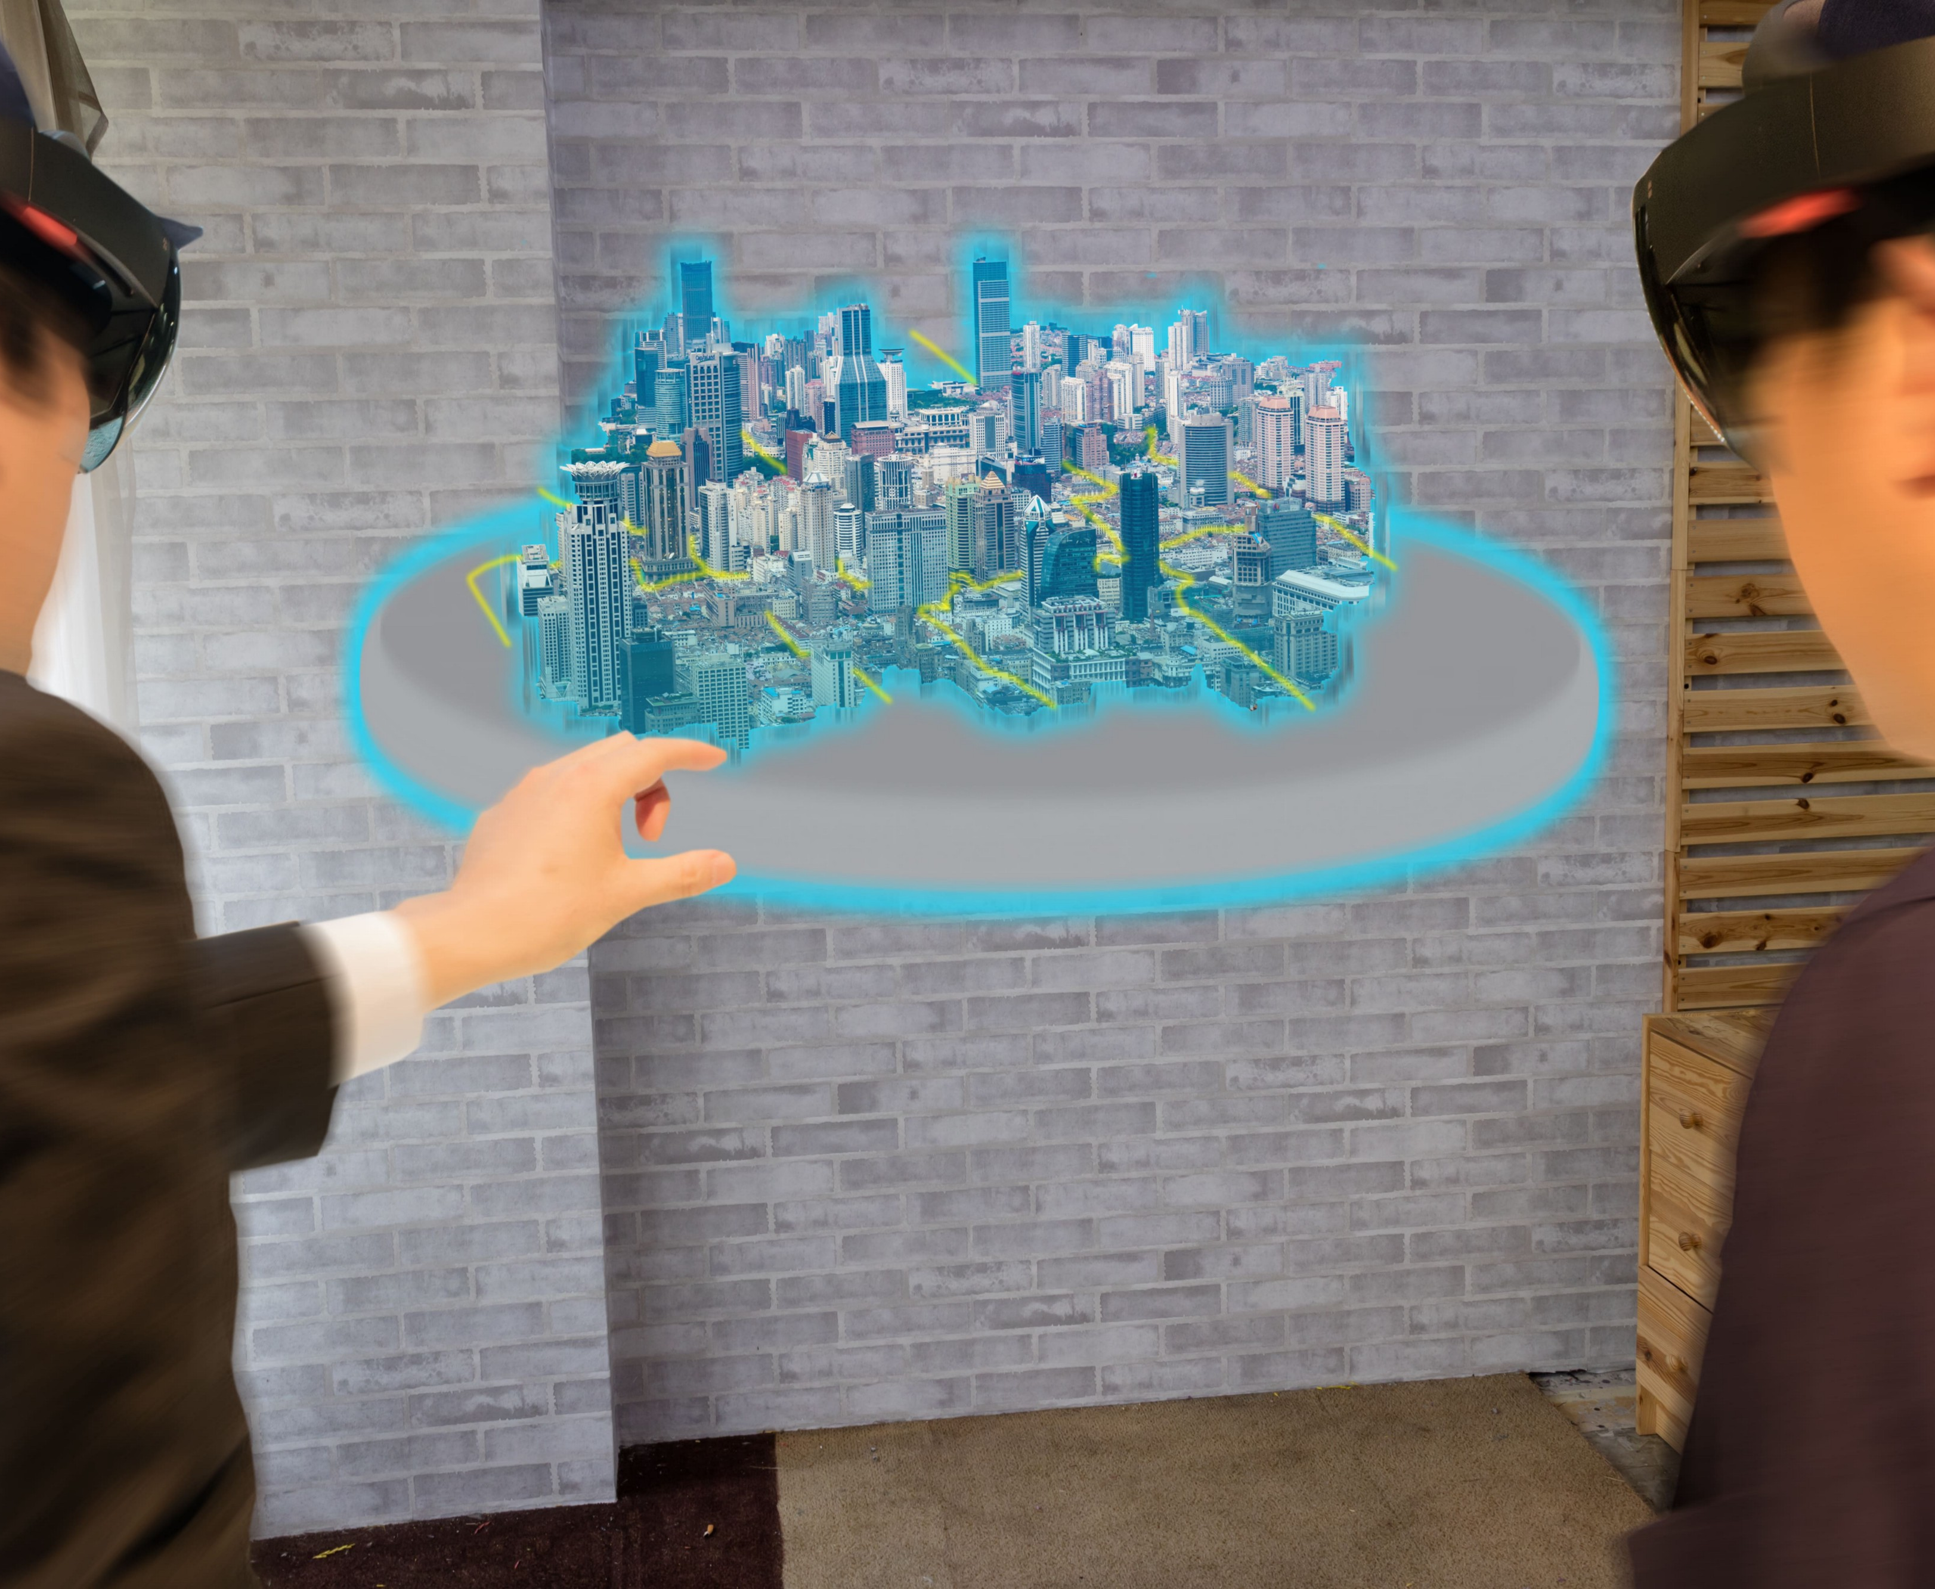
What is Augmented Reality?
Augmented Reality is a virtual image reflected on the real world.
Differences between Virtual Reality and Mixed Reality
Notes:
There are three different methods of digital realities, virtual, augmented, and mixed reality. Augmented Reality is a digital image reflected on the real world. Virtual reality is an entire digital world view. Mixed reality is projected on the real world and can be manipulated more then augmented reality.

Slide 3
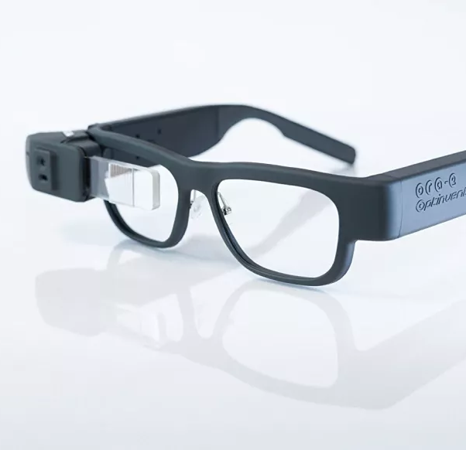
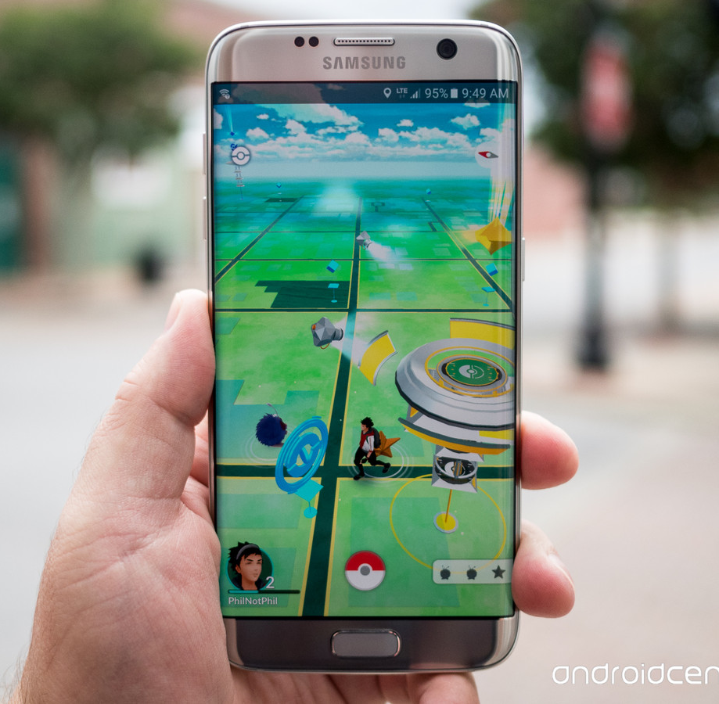
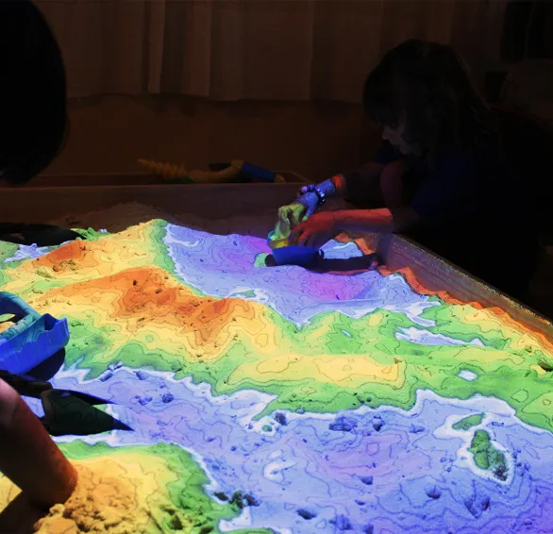
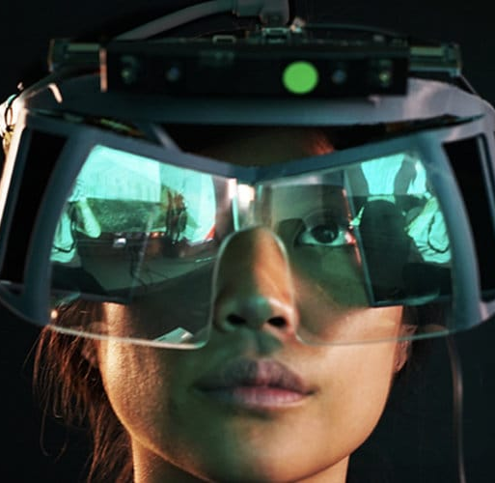
Forms of Augmented Reality
Projection Based Systems
Phone apps
Headsets/Glasses
Notes:
Research indicates three methods of augmented reality, projection based systems, phone apps, and headsets or glasses.

Slide 4
Elderly Health Issues
Dementia
Medication Schedules.
Falls
Burns
Isolation
Emotional Issues
Notes:
Common issues the elderly have with aging and that often create challenges for aging in place.

Slide 5
Elderly and Augmented Reality
Complex projection systems for Augmented Reality
Glasses
Phones
Notes:
The Elderly need a system to that is often with them at all times, complex projections would only work at home. Phones could be misplaced easily. The best method would be a style of glasses.

Slide 6
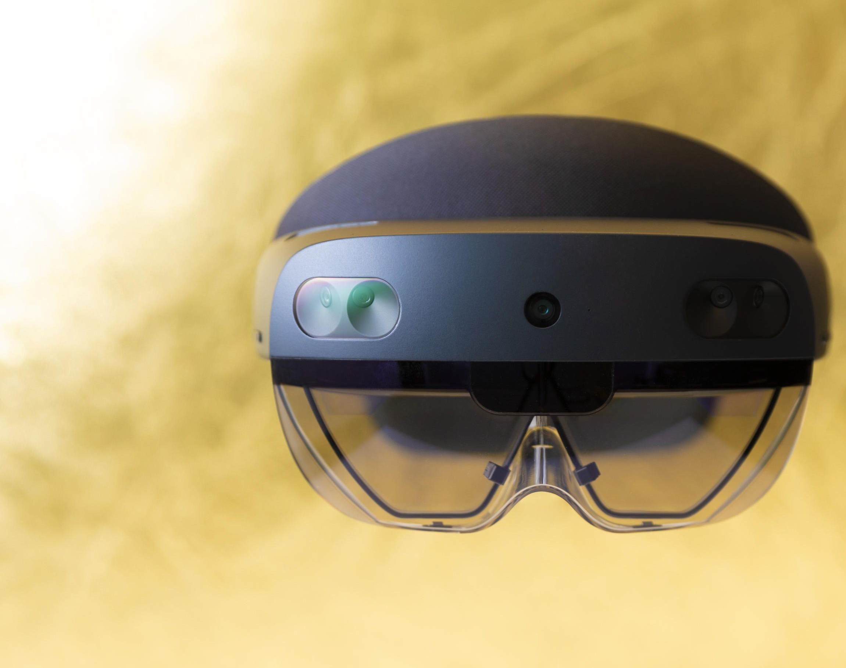
Common Design Issues
Too heavy.
Uncomfortable
Attract too much attention.
Cognitive Overload
Notes:
Common issues with headsets are they are too heavy, uncomfortable, attract too much attention and cognitive overload. These issues could be solved by making a different form of glasses.

Slide 7
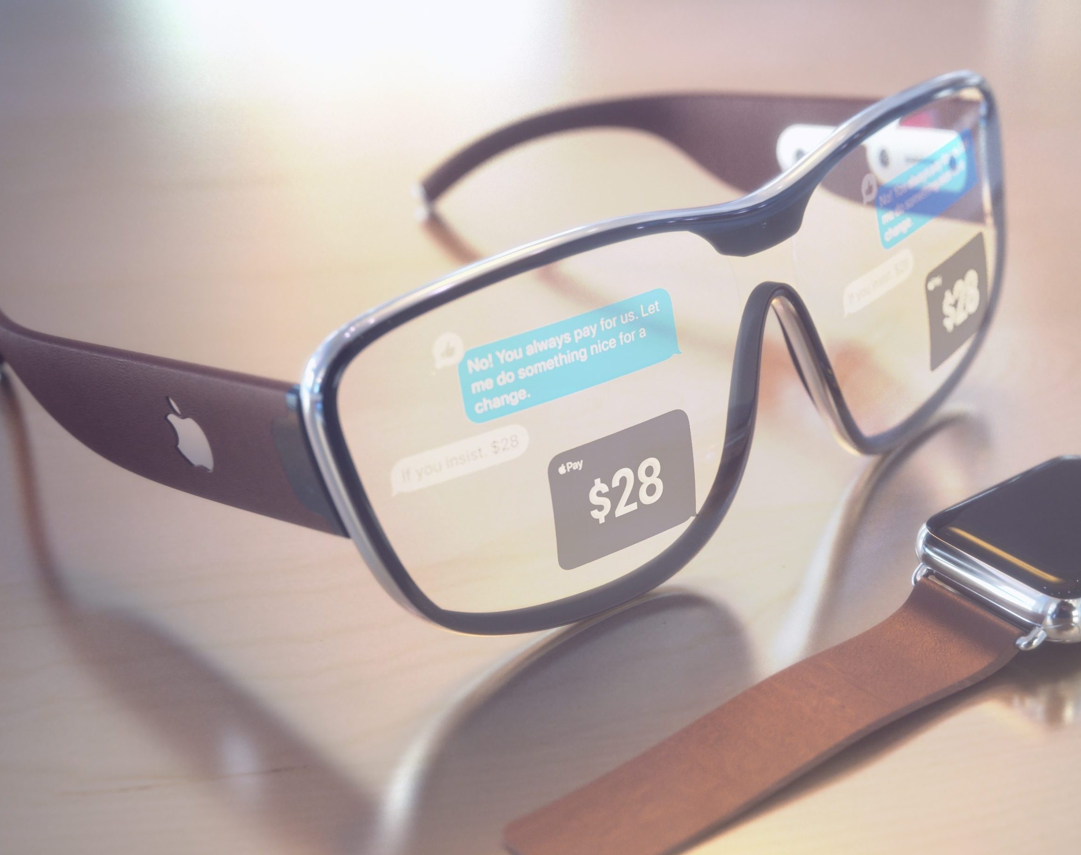
My Design
Appear as normal glasses
Link to a phone system rather then a independent system
Notification system viewed through glasses
Tracking system of items if needed.
Rely on app creators.
Hand tracking as well as manual side controls.
Notes:
I would make a design that appears like normal glasses, links to a phone system rather then an independent system to reduce weight. It would also allow notifications from the phone to be viewed through the lenses, and have a tracking system for items that may be needed such as medicines. To save money, the company will rely on an already created app store, rather then have to build their own. The glasses will be controlled with hand tracking as well as manual side controls.

Slide 8




Effects of Using Augmented Reality
Helps with medications
Fall detection
Assistance with cooking
Getting emergency services
Emotional Help
Socialization
This Photo by Unknown Author is licensed under CC BY-SA
Notes:
Using this system would help with medication administration, fall detection, assistance with cooking, getting emergency services, as well as emotional help and socizalization.

Slide 9

Issues
Cognitive Overload
App effectiveness
Costs
Caregiver
Notes:
Cognitive Overload would probably be an issue for some, but hopefully would decrease overtime. App effectiveness would hopefully be high and reviews would help seniors and caregivers avoid bad apps. Costs may be high for seniors, especially those on fixed income. Caregivers may also be reluctant to trust such technology.

Slide 10
Final Comments and Questions

